Slide 1

Copyright © 2024 - PartikelART
INDUSTRIAL DATA SCIENCE 2
CASE STUDY- GROUP III
Image Classification and Segmentation of Metal and Non-Metal Particles
HARSH YADAV | ANANYA PAL | RAJ ANILBHAI PAWAR |SAPTARSI BHATTACHARYA | PURVANSHI SHARMA

Slide 2
Previously Done
Copyright © 2024 - PartikelART
Problem Statement – In industries where precision and reliability are crucial, the presence of contaminants such as metal and non-metal particles can lead to significant quality issues. Objective was to classify and segment metal and non-metal particles using high-resolution images from a microscope and low-resolution images from a mobile phone.
Importance: Accurate classification and segmentation are crucial for various industrial and research applications.
Solution– To address the challenge of particle analysis, we use YOLO and CNN models, and compare their results.
HARSH YADAV | ANANYA PAL | RAJ ANILBHAI PAWAR |SAPTARSI BHATTACHARYA | PURVANSHI SHARMA

Slide 3
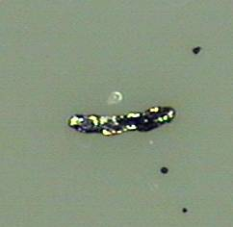
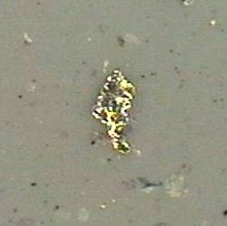
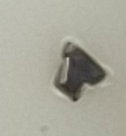
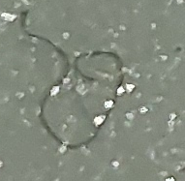
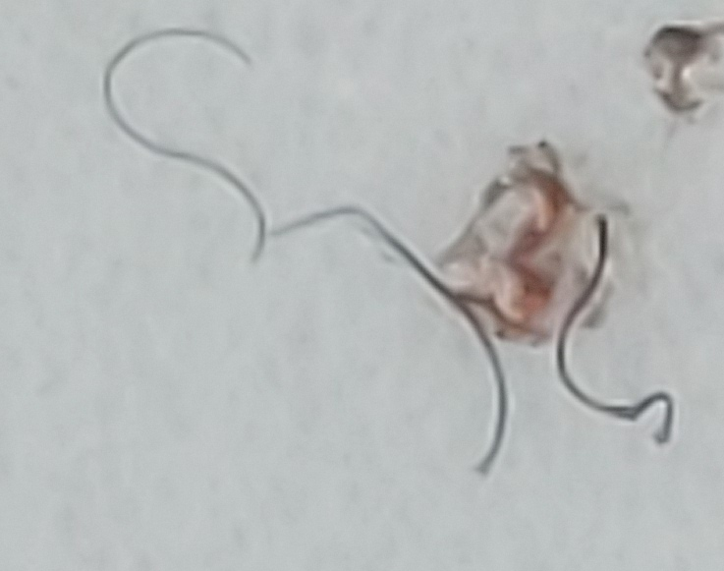
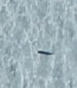
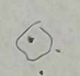
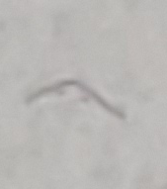
Previously Done - Data Description
Copyright © 2024 - PartikelART
Data Sources: Images from a microscope (high resolution) and a mobile phone (low resolution).
Image Dimensions: Non consistent
Classes: Metal, Non-metal
Challenges: Insufficient image data generated from mobile phone, variability in image quality.
HARSH YADAV | ANANYA PAL | RAJ ANILBHAI PAWAR |SAPTARSI BHATTACHARYA | PURVANSHI SHARMA

Slide 4
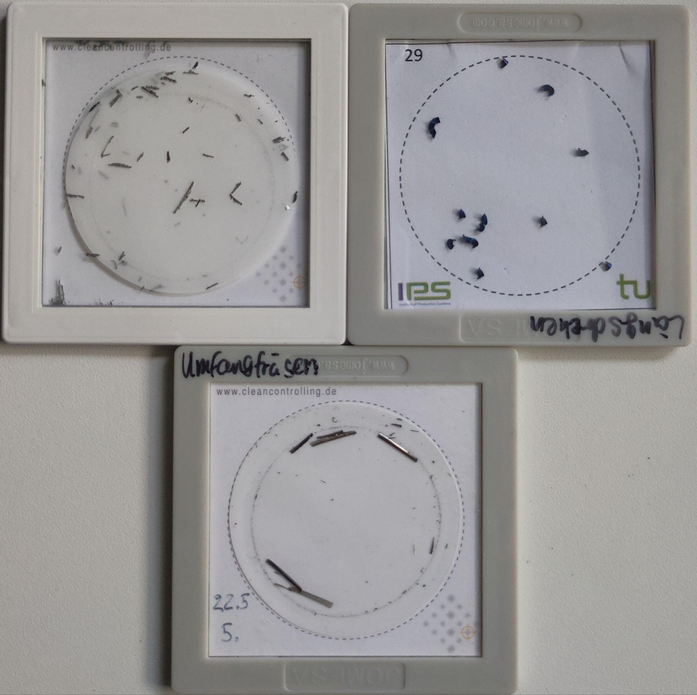
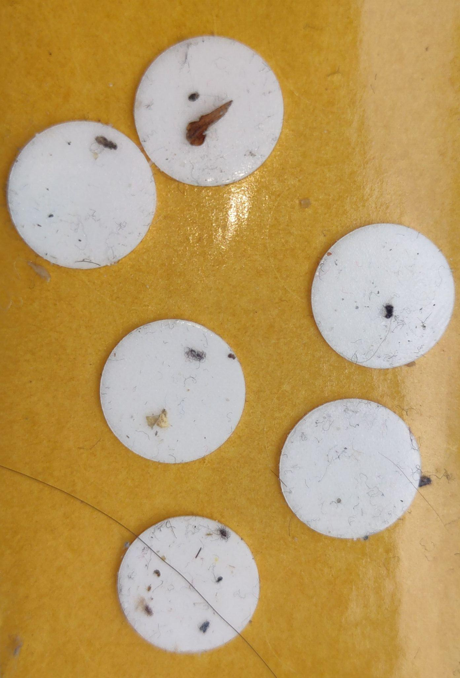
Previously Done - Data Description
Copyright © 2024 - PartikelART
Data Sources: Images from a microscope (high resolution) and a mobile phone (low resolution).
Image Dimensions: Non consistent
Classes: Metal, Non-metal
Challenges: Insufficient image data generated from mobile phone, variability in image quality.
HARSH YADAV | ANANYA PAL | RAJ ANILBHAI PAWAR |SAPTARSI BHATTACHARYA | PURVANSHI SHARMA

Slide 5
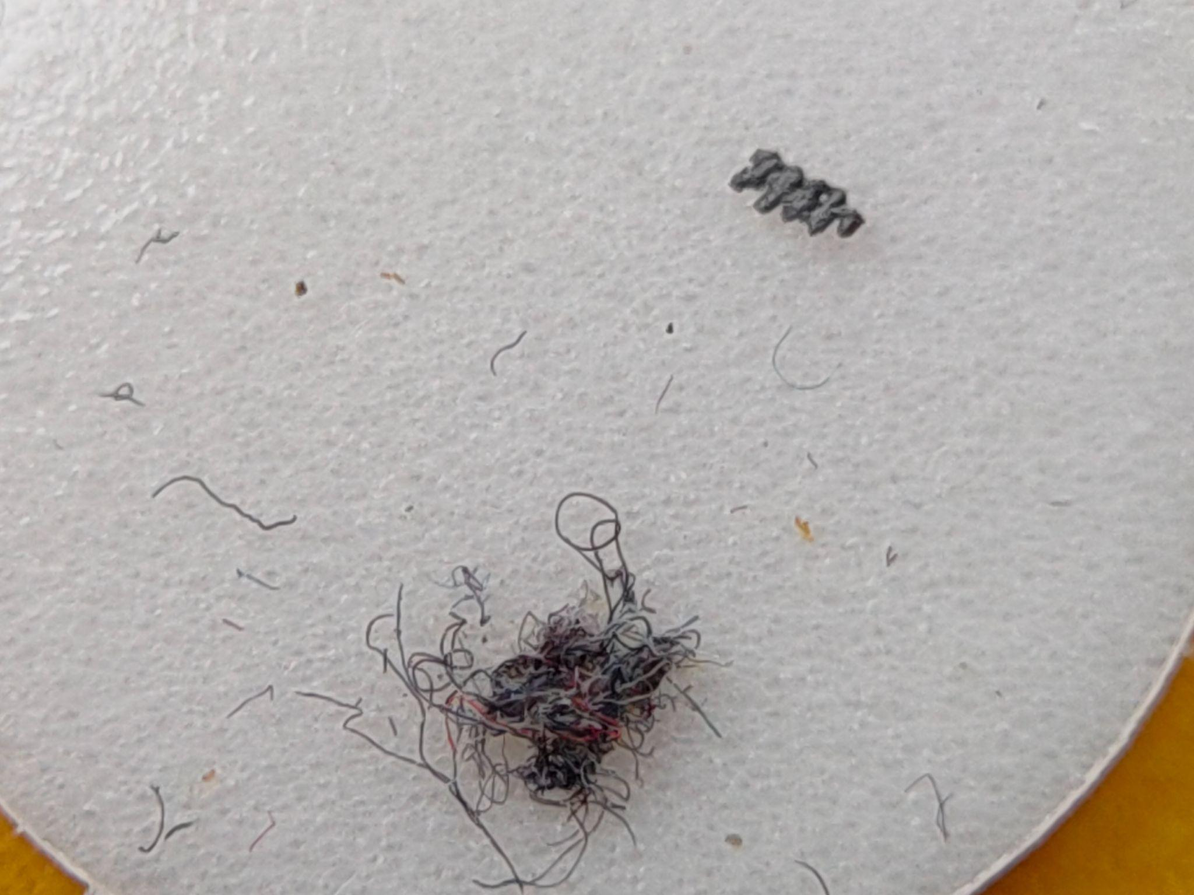
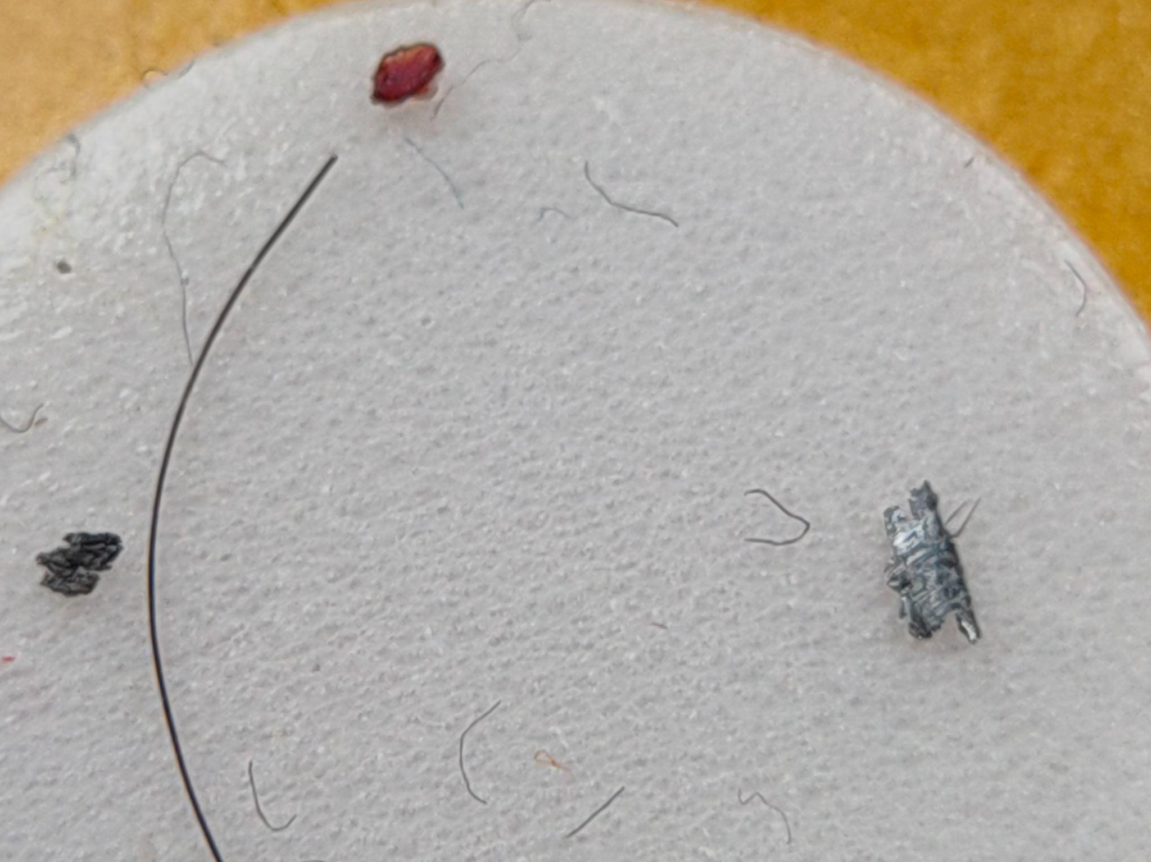
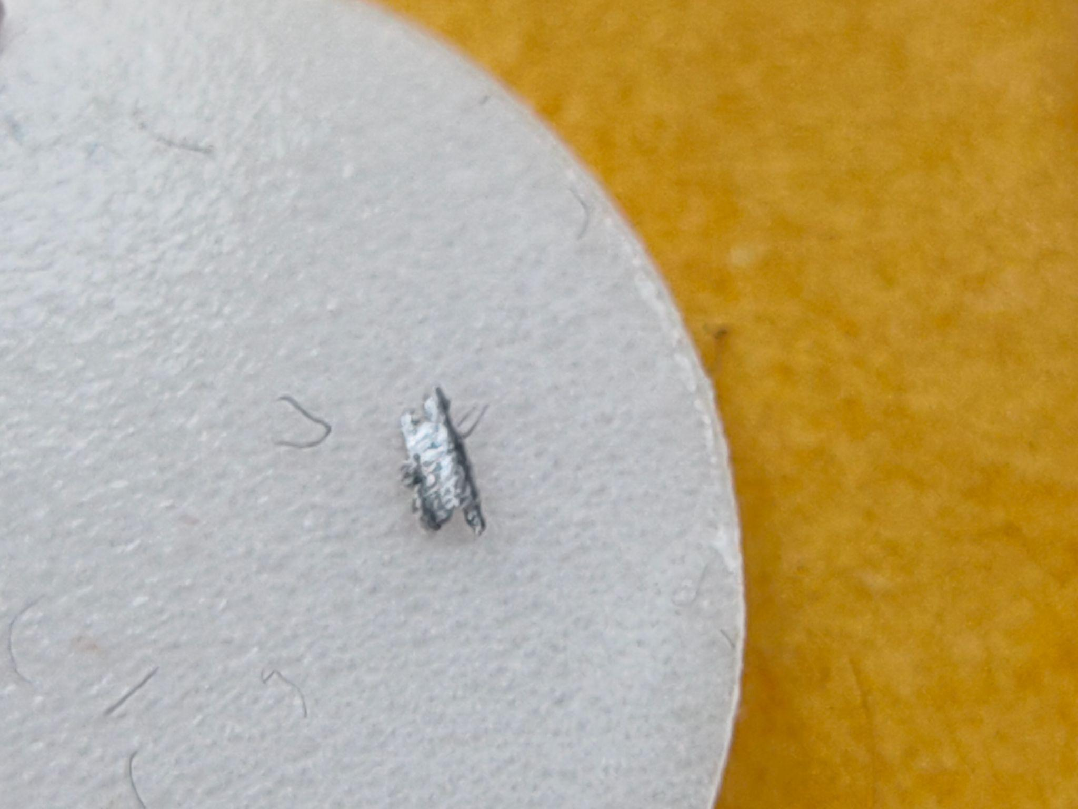
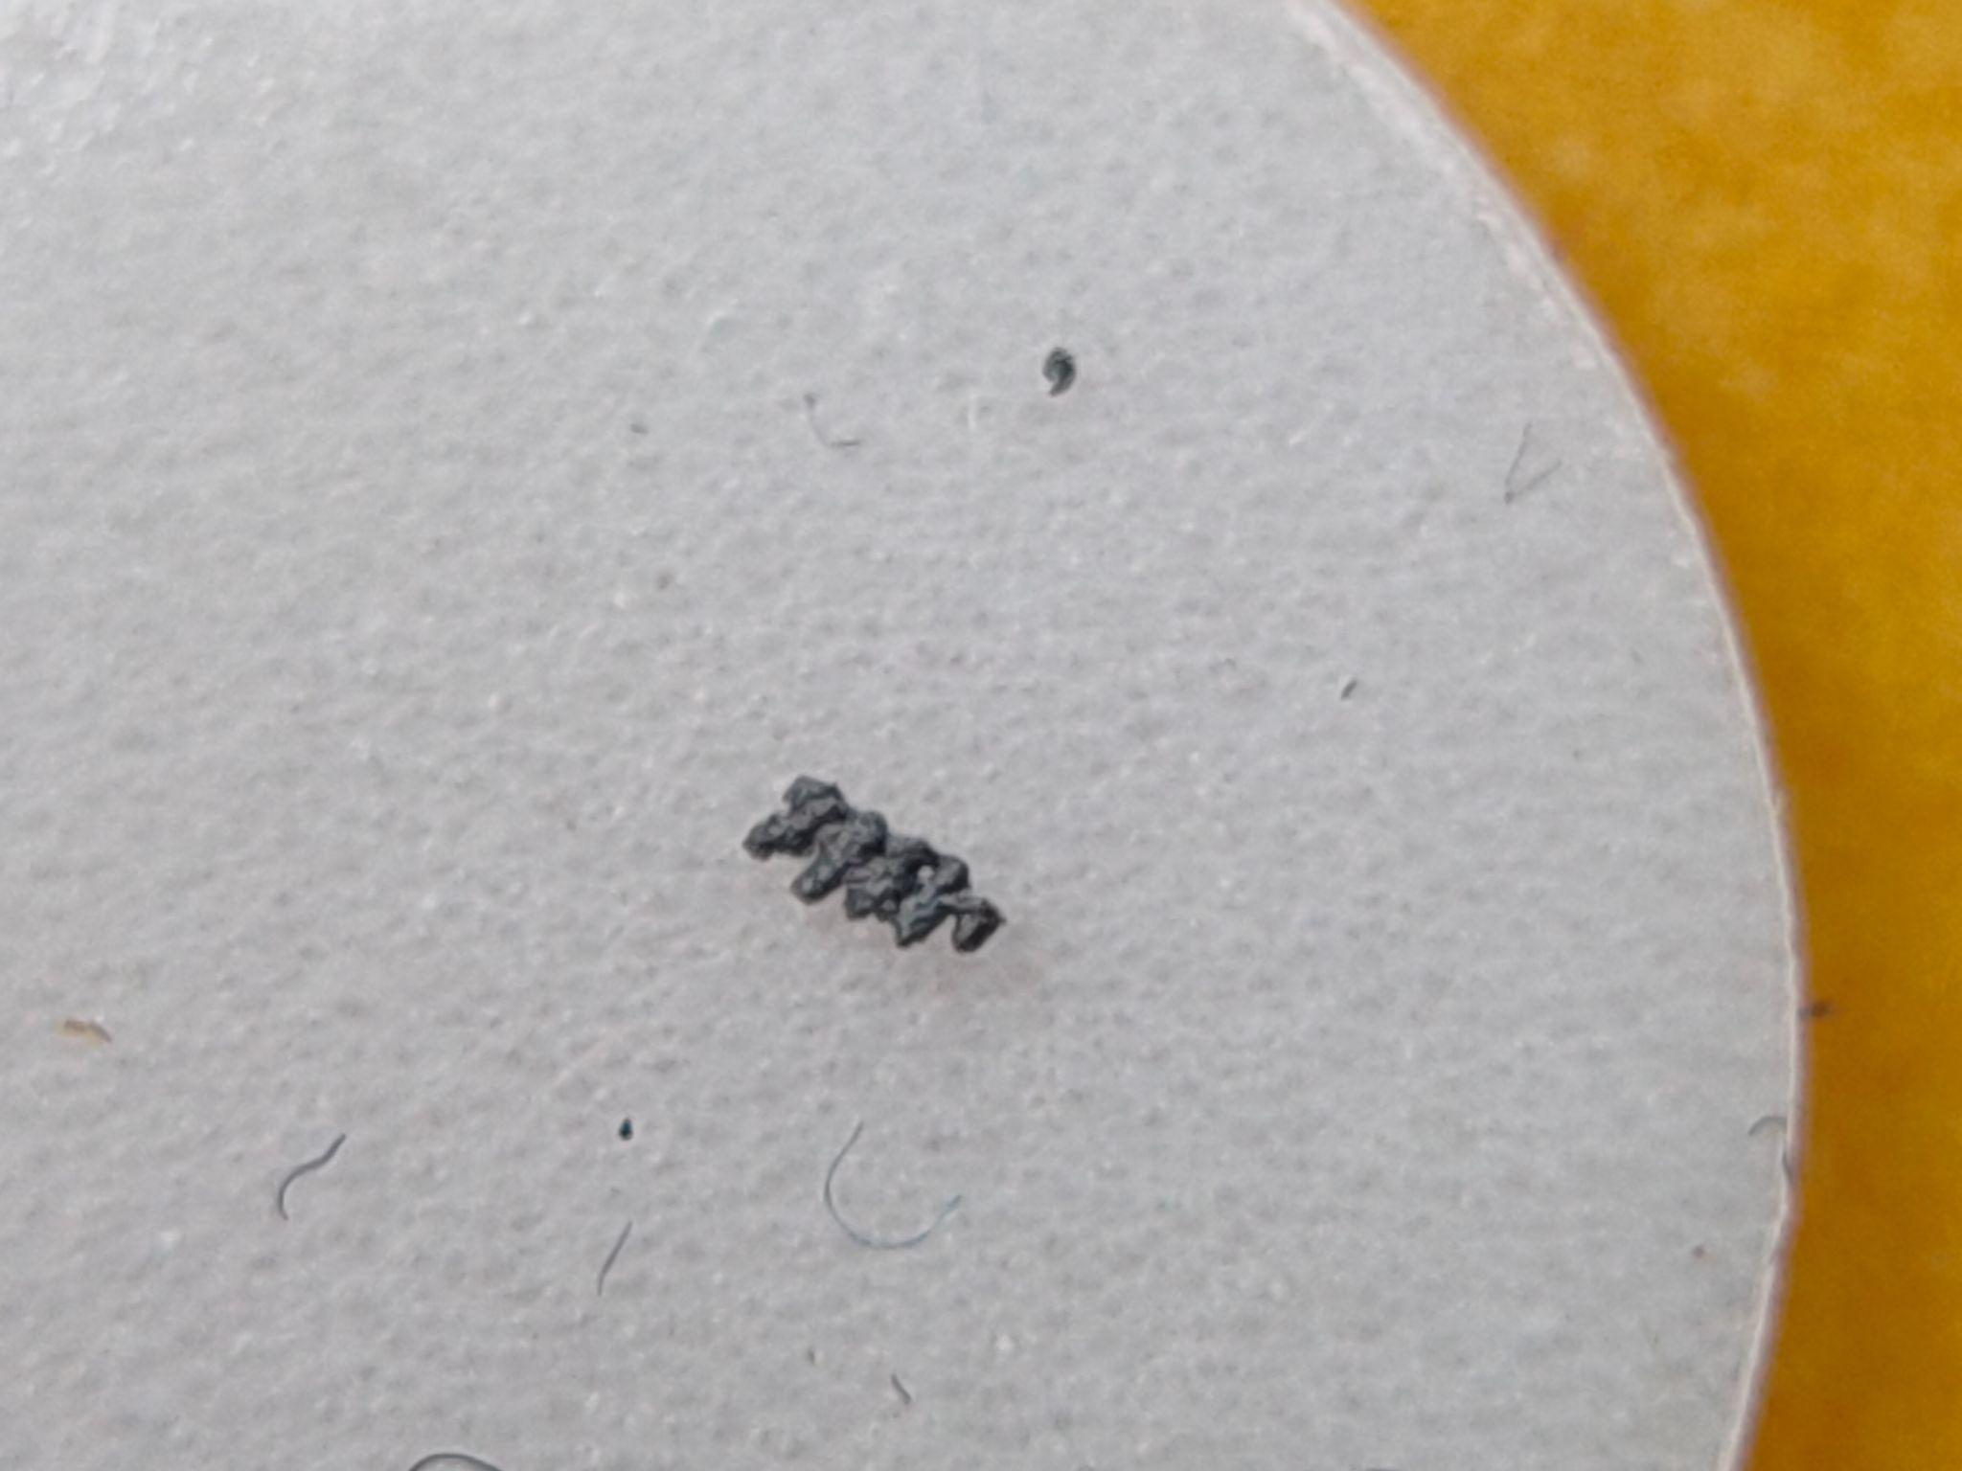
Previously Done - Data Description
Copyright © 2024 - PartikelART
Data Sources: Images from a microscope (high resolution) and a mobile phone (low resolution).
Image Dimensions: Non consistent
Classes: Metal, Non-metal
Challenges: Insufficient image data generated from mobile phone, variability in image quality.
HARSH YADAV | ANANYA PAL | RAJ ANILBHAI PAWAR |SAPTARSI BHATTACHARYA | PURVANSHI SHARMA

Slide 6
Data Preparation
Copyright © 2024 - PartikelART
Data Augmentation
Techniques Used: Rotation, Flipping, Scaling, Cropping.
Models Used
YOLOv8: For object detection and instance segmentation.
Classical CNN: For image classification.
U-Net: For image segmentation.
HARSH YADAV | ANANYA PAL | RAJ ANILBHAI PAWAR |SAPTARSI BHATTACHARYA | PURVANSHI SHARMA

Slide 7
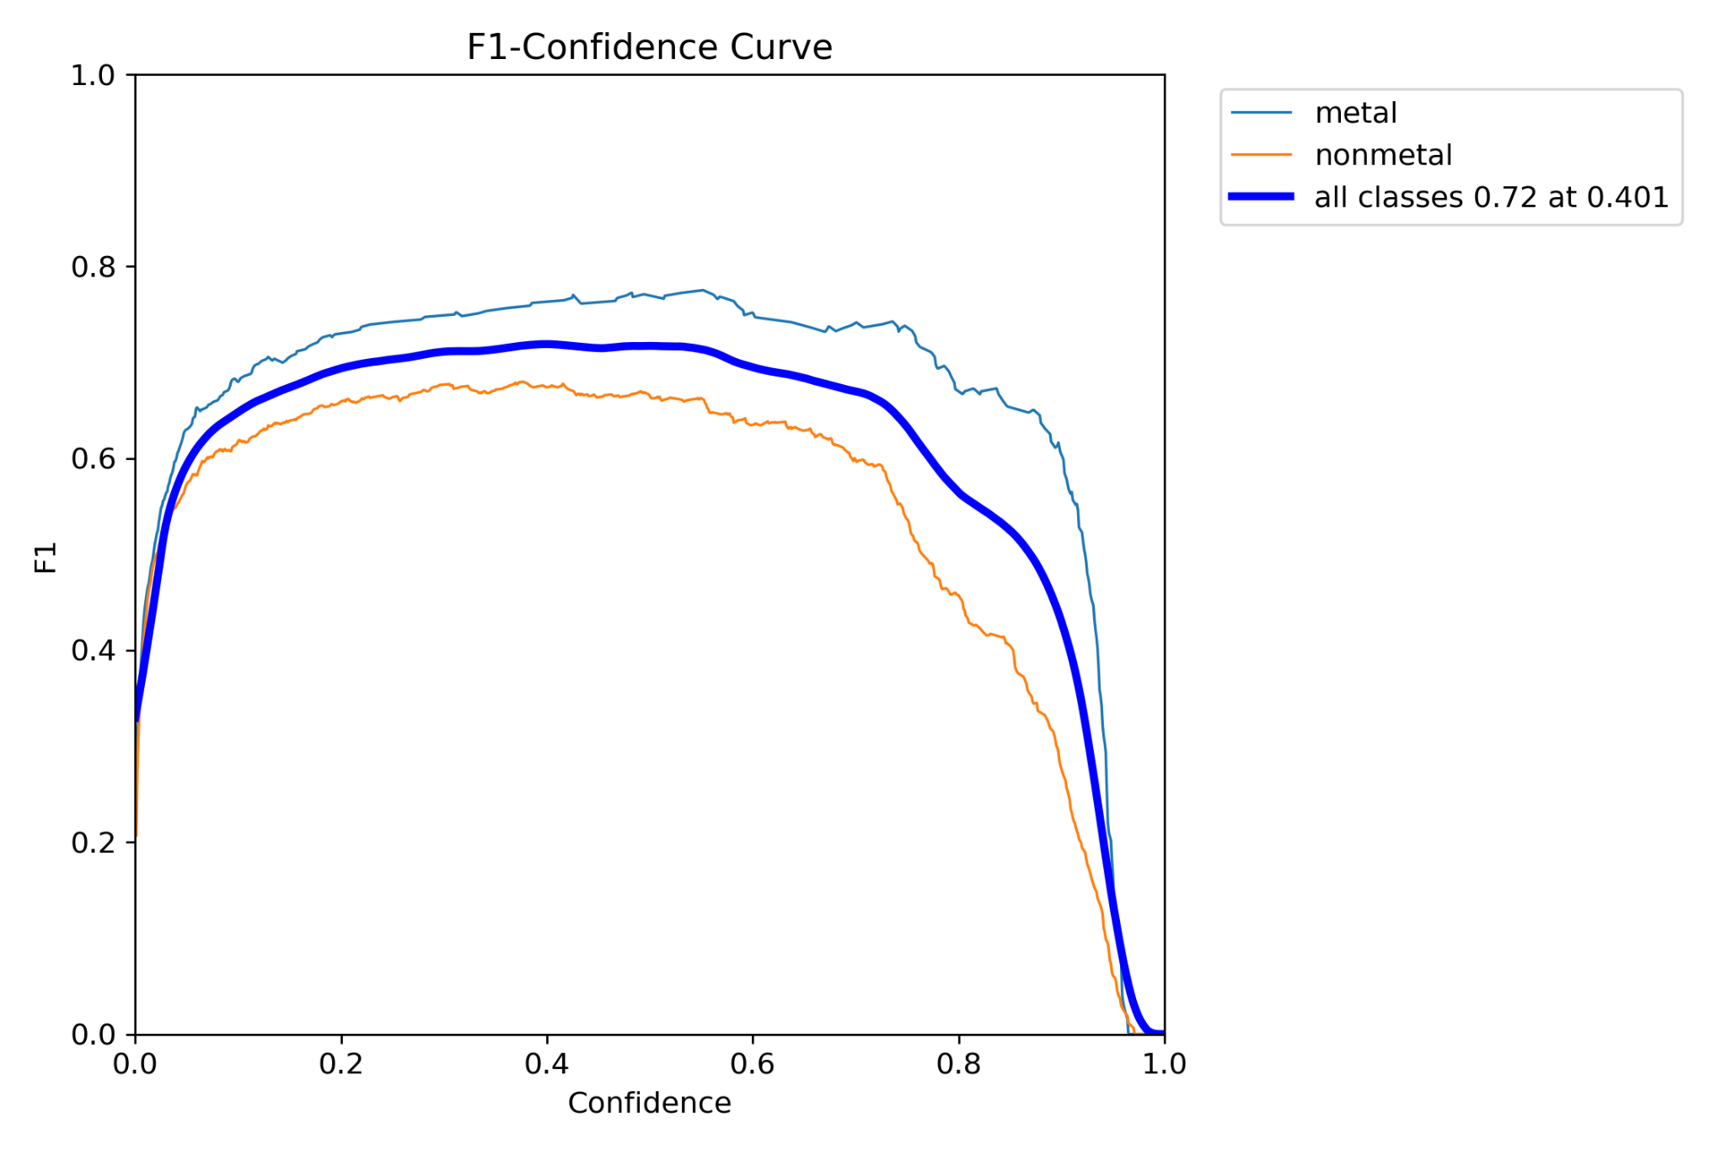
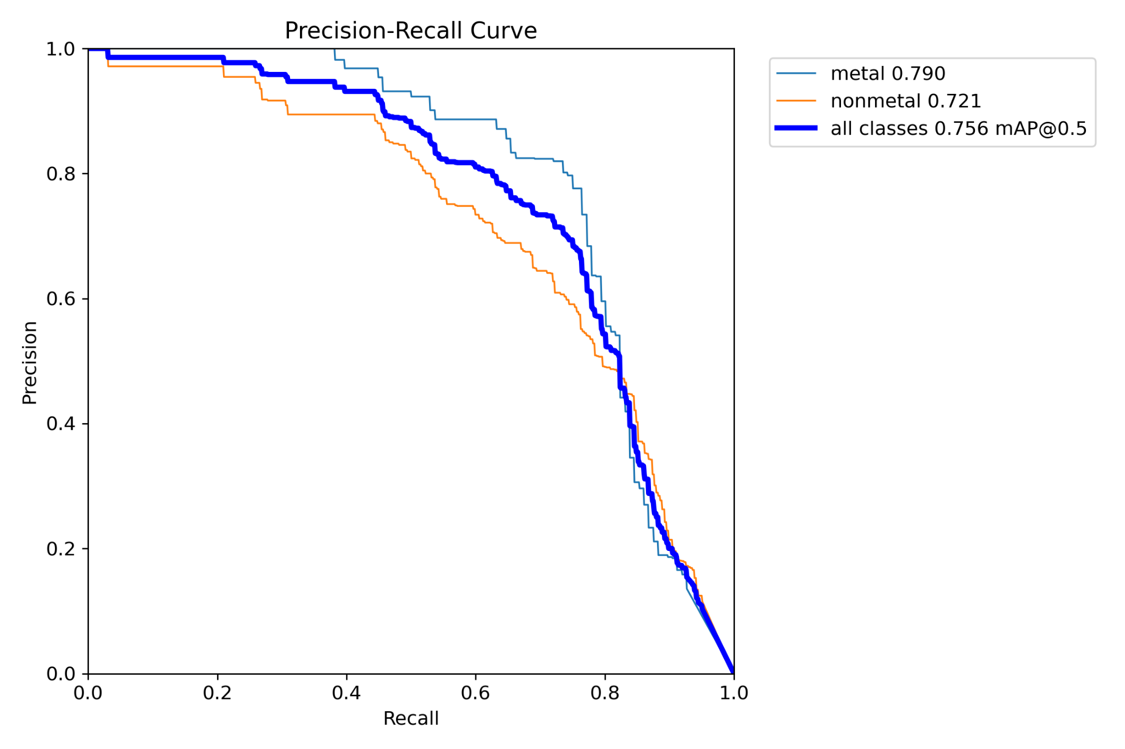
YOLO v8n Model
Copyright © 2024 - PartikelART
HARSH YADAV | ANANYA PAL | RAJ ANILBHAI PAWAR |SAPTARSI BHATTACHARYA | PURVANSHI SHARMA

Slide 8
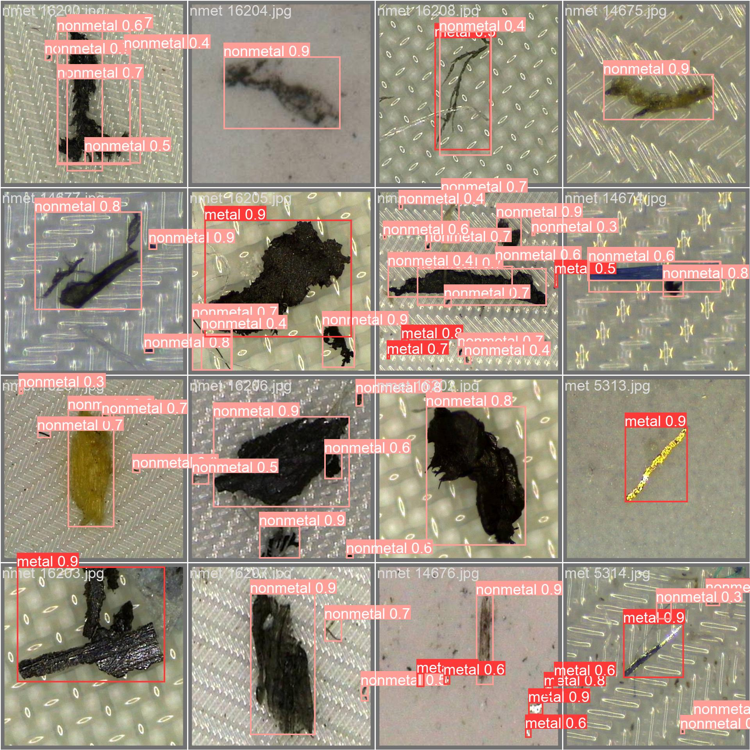
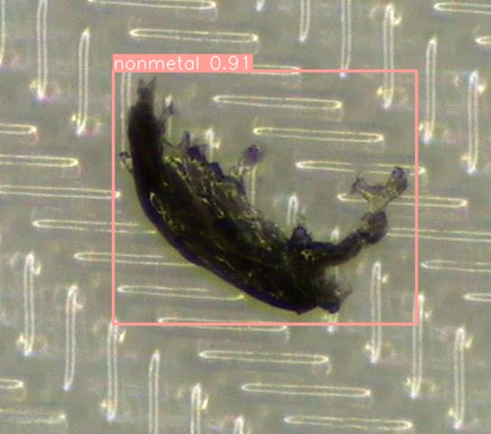
YOLOv8 Results (Microscope - Object Detection)
Copyright © 2024 - PartikelART
HARSH YADAV | ANANYA PAL | RAJ ANILBHAI PAWAR |SAPTARSI BHATTACHARYA | PURVANSHI SHARMA

Slide 9
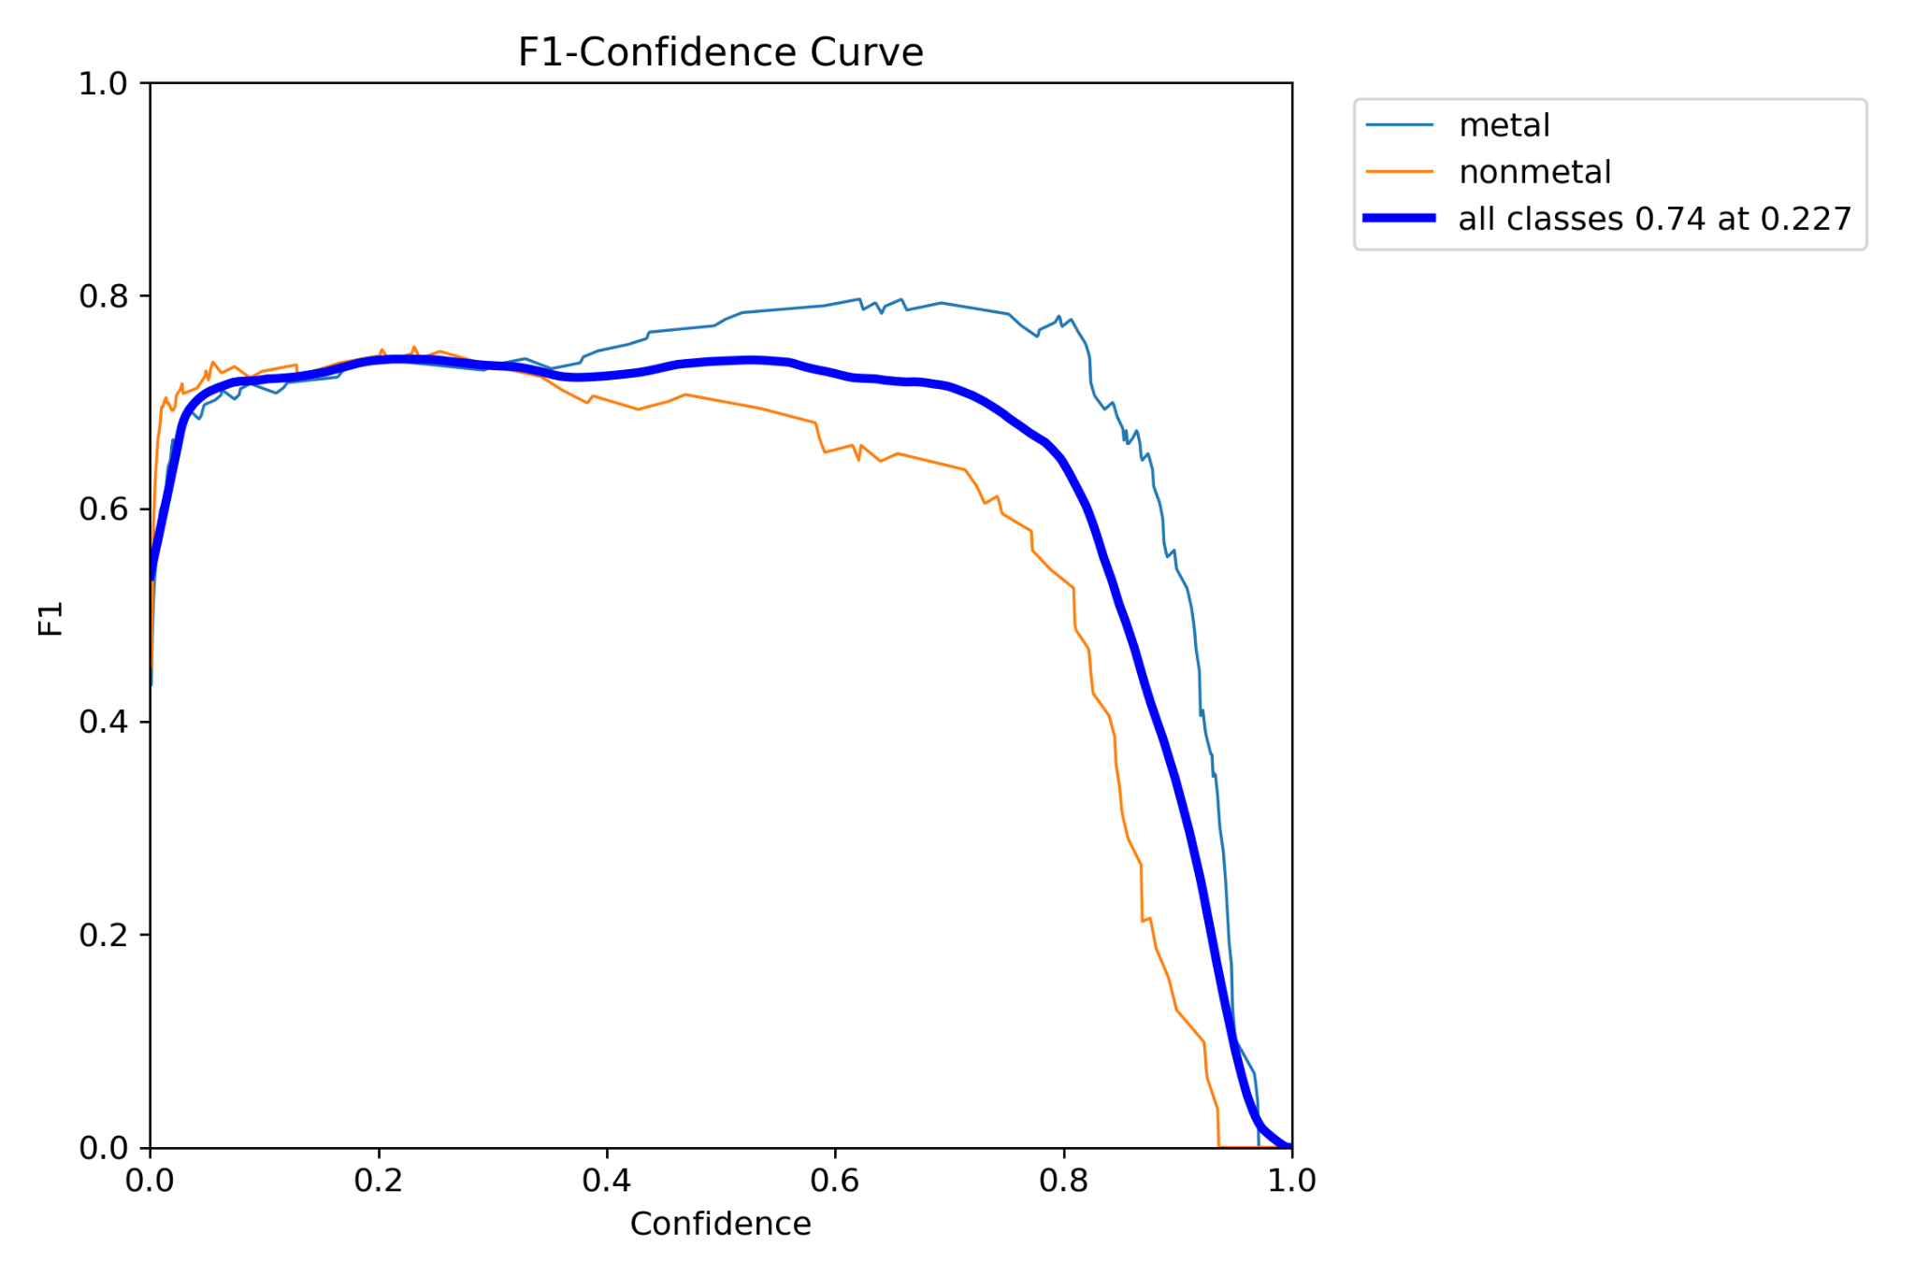
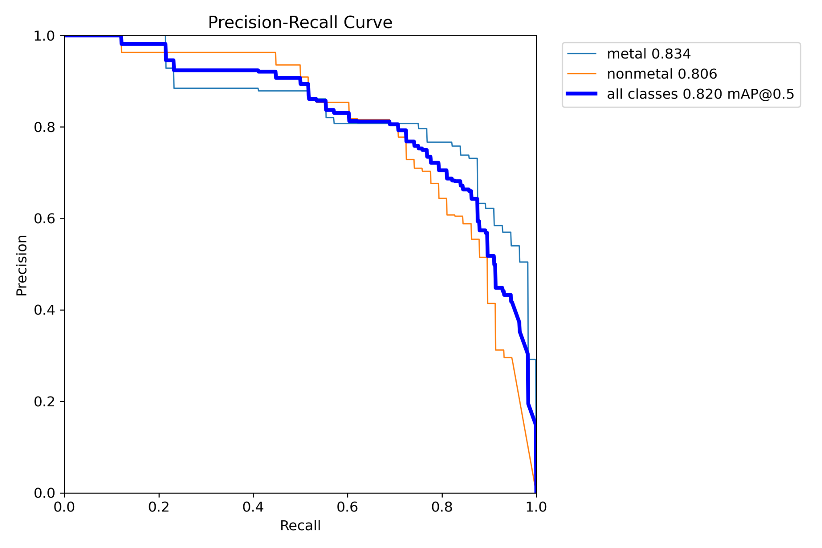
YOLOv8 Results (Mobile)
Copyright © 2024 - PartikelART
HARSH YADAV | ANANYA PAL | RAJ ANILBHAI PAWAR |SAPTARSI BHATTACHARYA | PURVANSHI SHARMA

Slide 10
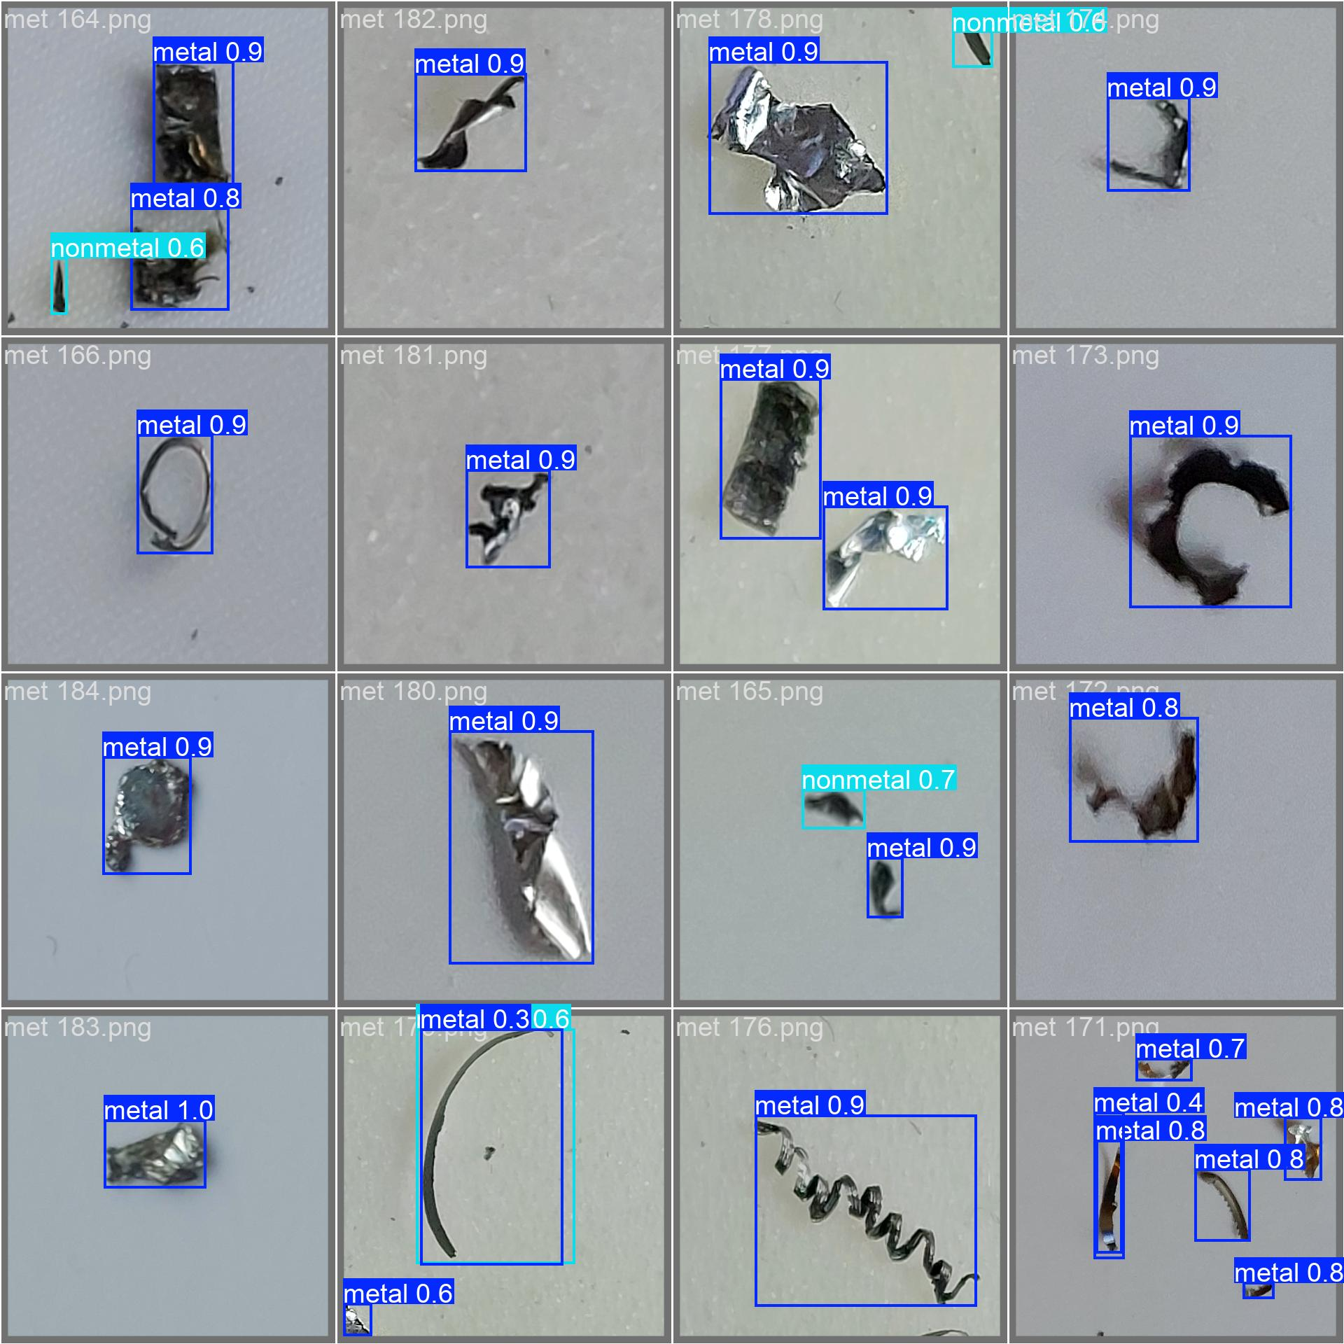
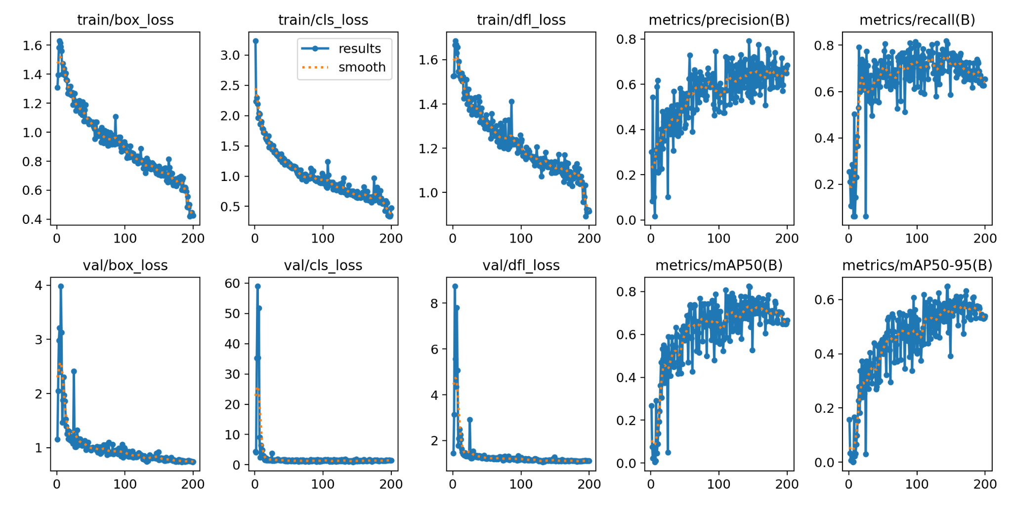
YOLOv8 Results (Mobile)
Copyright © 2024 - PartikelART
HARSH YADAV | ANANYA PAL | RAJ ANILBHAI PAWAR |SAPTARSI BHATTACHARYA | PURVANSHI SHARMA

Slide 11
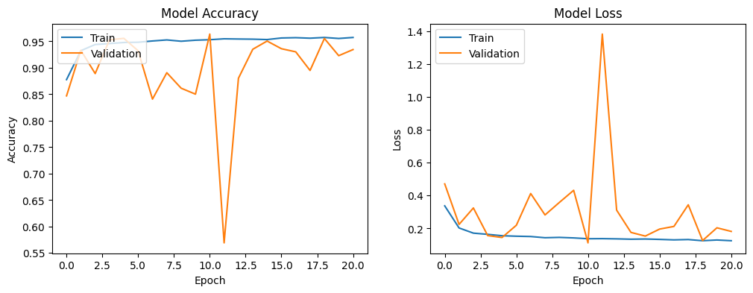
Classical CNN Model
Copyright © 2024 - PartikelART
HARSH YADAV | ANANYA PAL | RAJ ANILBHAI PAWAR |SAPTARSI BHATTACHARYA | PURVANSHI SHARMA

Slide 12
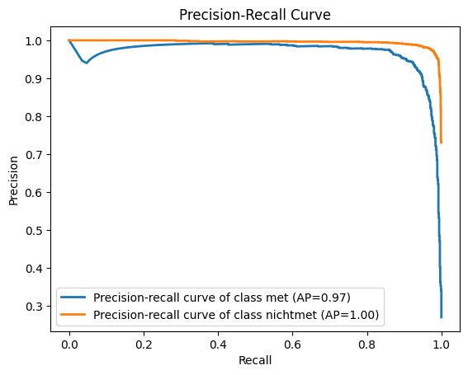
Classical CNN Model
Copyright © 2024 - PartikelART
HARSH YADAV | ANANYA PAL | RAJ ANILBHAI PAWAR |SAPTARSI BHATTACHARYA | PURVANSHI SHARMA

Slide 13
Classical CNN Model
Copyright © 2024 - PartikelART
HARSH YADAV | ANANYA PAL | RAJ ANILBHAI PAWAR |SAPTARSI BHATTACHARYA | PURVANSHI SHARMA

Slide 14
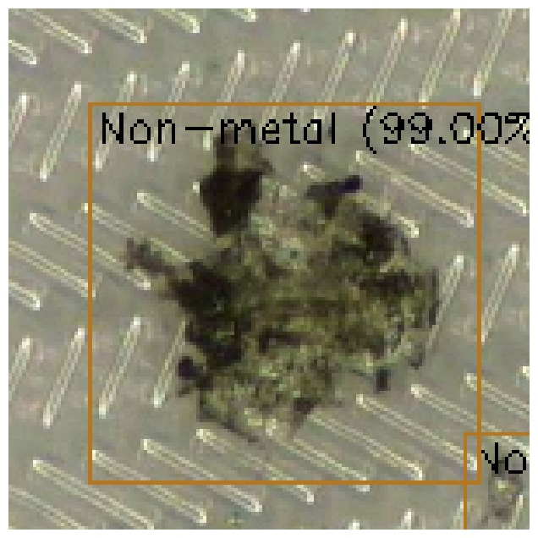
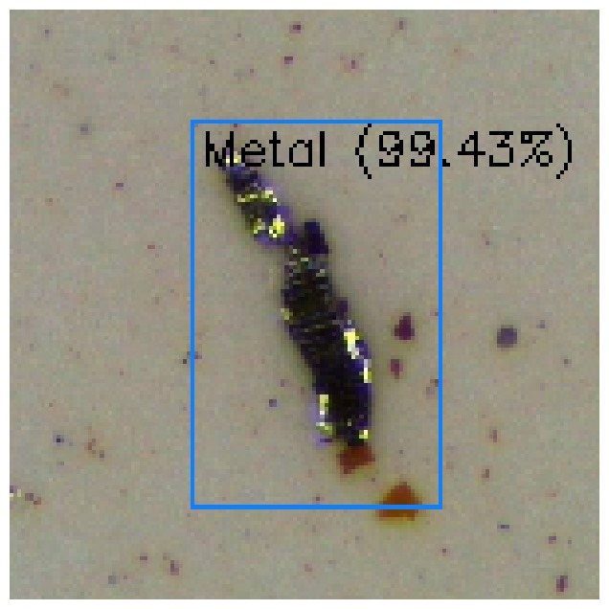
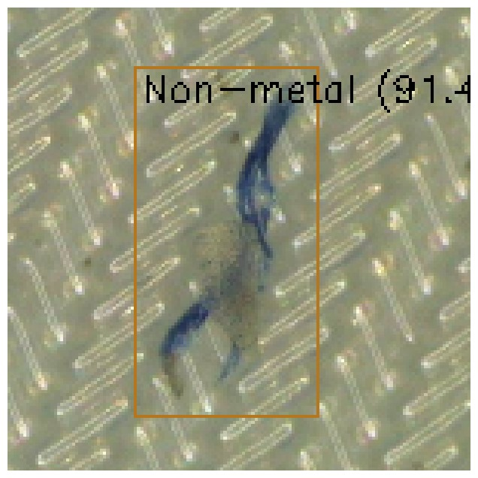
Classical CNN Model
HARSH YADAV | ANANYA PAL | RAJ ANILBHAI PAWAR |SAPTARSI BHATTACHARYA | PURVANSHI SHARMA
Notes:
The CNN model results demonstrate robust training and validation performance over 8 epochs. The accuracy graph indicates that both training and validation accuracy converge around 95%, showcasing the model's effectiveness. The loss graph reveals a consistent decrease in both training and validation loss, with convergence around a low loss value, further indicating the model's reliability. These results suggest that the CNN model generalizes well to new data and effectively learns the patterns required for accurate classification.

Slide 15
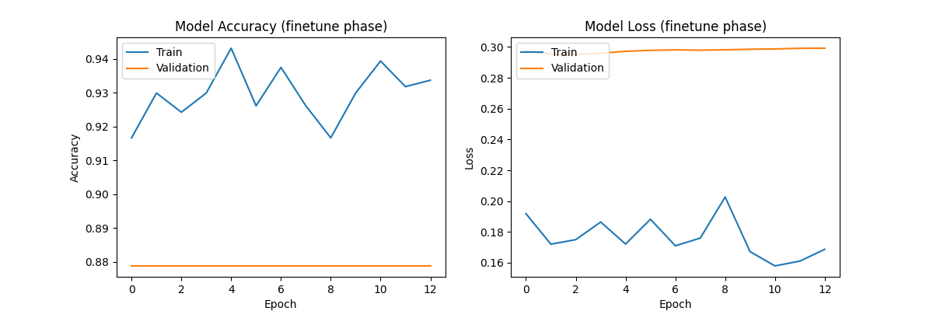
Classical CNN Results (Mobile)
Copyright © 2024 - PartikelART
HARSH YADAV | ANANYA PAL | RAJ ANILBHAI PAWAR |SAPTARSI BHATTACHARYA | PURVANSHI SHARMA

Slide 16
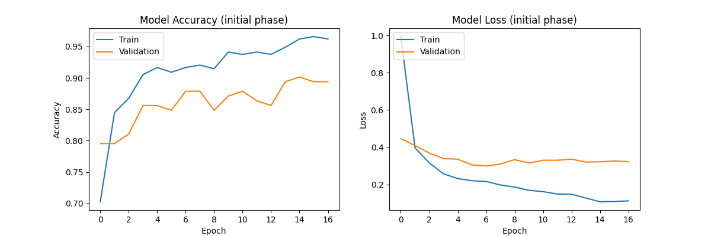
Classical CNN Results (Mobile)
Copyright © 2024 - PartikelART
HARSH YADAV | ANANYA PAL | RAJ ANILBHAI PAWAR |SAPTARSI BHATTACHARYA | PURVANSHI SHARMA

Slide 17
Classical CNN Results (Mobile)
Copyright © 2024 - PartikelART
HARSH YADAV | ANANYA PAL | RAJ ANILBHAI PAWAR |SAPTARSI BHATTACHARYA | PURVANSHI SHARMA

Slide 18
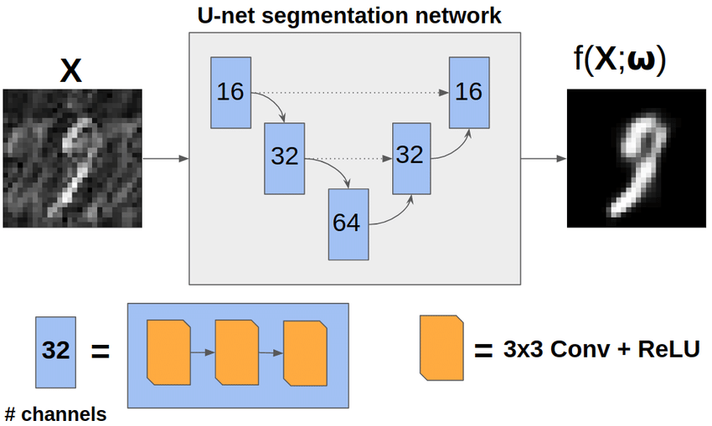
U-Net
Why U-Net:
Effective Segmentation Architecture
Handles Small Datasets Well
Proven Accuracy
It's a CNN designed for segmentation tasks, particularly known for its effectiveness even with limited data.
A Topological Loss Function for Deep-Learning Based Image Segmentation Using Persistent Homology - Scientific Figure on ResearchGate. Available from: https://www.researchgate.net/figure/Diagram-of-the-simple-U-net-architecture-used-in-experiment-1-Dotted-arrows-correspond_fig2_344127462 [accessed 18 Jul 2024]
HARSH YADAV | ANANYA PAL | RAJ ANILBHAI PAWAR |SAPTARSI BHATTACHARYA | PURVANSHI SHARMA

Slide 19
U-Net Implementation
Data Preparation:
Created image masks from YOLO annotations
Normalize and convert masks to .npy
Data Augmentation
Training Process:
Batch Size: 2
Epochs: 50
Learning Rate: 0.0001
A Topological Loss Function for Deep-Learning Based Image Segmentation Using Persistent Homology - Scientific Figure on ResearchGate. Available from: https://www.researchgate.net/figure/Diagram-of-the-simple-U-net-architecture-used-in-experiment-1-Dotted-arrows-correspond_fig2_344127462 [accessed 18 Jul 2024]
HARSH YADAV | ANANYA PAL | RAJ ANILBHAI PAWAR |SAPTARSI BHATTACHARYA | PURVANSHI SHARMA

Slide 20
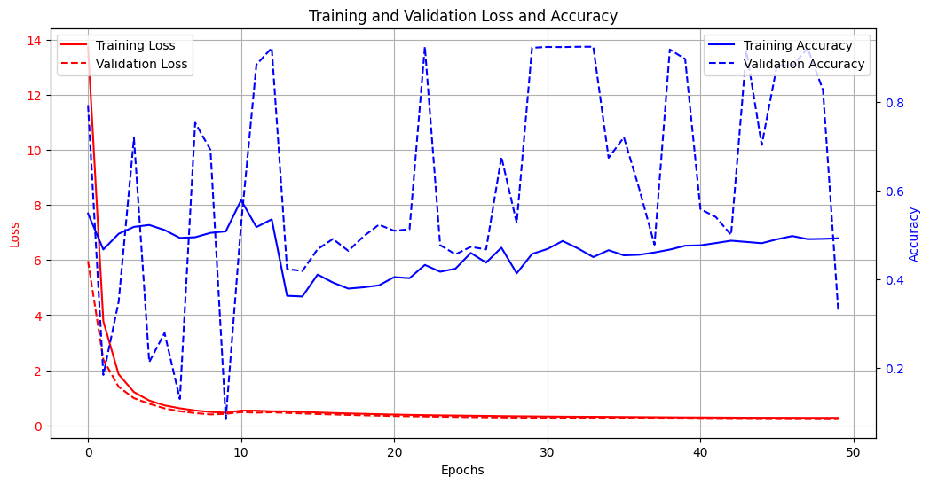
Unet - Results and Discussion
Performance:
Loss and Accuracy Plot
Example Segmentation Results
Challenges and Future Work:
Dataset Quality
Hyperparameter Tuning
Exploring New Architectures
HARSH YADAV | ANANYA PAL | RAJ ANILBHAI PAWAR |SAPTARSI BHATTACHARYA | PURVANSHI SHARMA

Slide 21
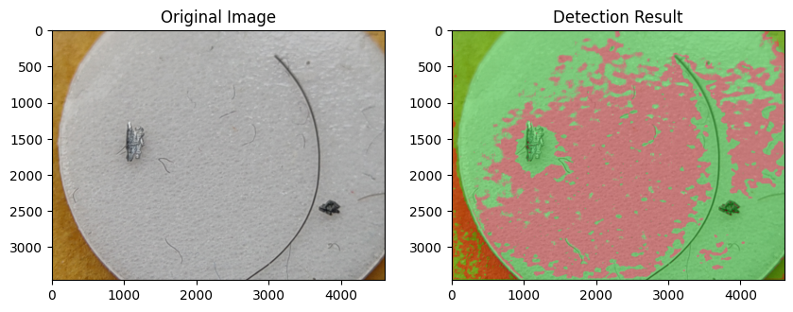
Unet - Results and Discussion
Performance:
Loss and Accuracy Plot
Example Segmentation Results
Challenges and Future Work:
Dataset Quality
Hyperparameter Tuning
Exploring New Architectures
HARSH YADAV | ANANYA PAL | RAJ ANILBHAI PAWAR |SAPTARSI BHATTACHARYA | PURVANSHI SHARMA

Slide 22
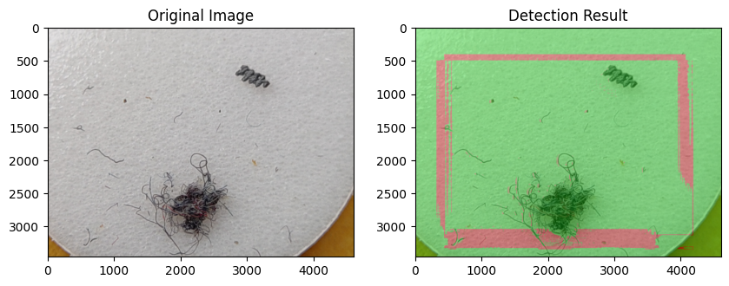
Unet - Results and Discussion
Performance:
Loss and Accuracy Plot
Example Segmentation Results
Challenges and Future Work:
Dataset Quality
Hyperparameter Tuning
Exploring New Architectures
HARSH YADAV | ANANYA PAL | RAJ ANILBHAI PAWAR |SAPTARSI BHATTACHARYA | PURVANSHI SHARMA

Slide 23
Conclusion
Need to increase the dataset size for better model training.
Model Optimization: Experiment with different architectures and hyperparameters.
HARSH YADAV | ANANYA PAL | RAJ ANILBHAI PAWAR |SAPTARSI BHATTACHARYA | PURVANSHI SHARMA

Slide 24
References
1. YOLOv8 Model https://github.com/ultralytics, author = {Glenn Jocher, Et al.}, year = 2023, url = {https://github.com/ultralytics/ultralytics}
2. Scikit-learn, author = {Pedregosa, Et al.}, year = 2011
3. Matplotlib, author = {Hunter, Et.al.}, year = 2007
4. Tensorflow, author = {Paul and Chen, Et. al.}, year = 2016
5. NumPy, author = {Charles R. Harris, Et al.}, year = 2020
6. OpenCV, author = {Bradski, G., Et.al.}, year = 2000
HARSH YADAV | ANANYA PAL | RAJ ANILBHAI PAWAR |SAPTARSI BHATTACHARYA | PURVANSHI SHARMA

Slide 25
Q&A!
HARSH YADAV | ANANYA PAL | RAJ ANILBHAI PAWAR |SAPTARSI BHATTACHARYA | PURVANSHI SHARMA

